Slide 1


ORCHID: Orchestrated Delta Workflow Integration and Deployment
Ranvitha Parshi
1

Slide 2
Agenda
1. INTRODUCTION
2. CURRENT ARCHITECTURE
3. SOLUTION
4. LOW-LEVEL IMPLEMENTATION
5. RESULTS
6. FUTURE SCOPE

Slide 3
INTRODUCTION
3

Slide 4
INTRODUCTION
In current update workflows are facing a recurring challenge- processing entire datasets even when there is a significant overlap between current and previous datasets.
To address these challenges, this project focuses on developing a mechanism to identify and isolate delta(diff) and stale data between the current and previous datasets.
26/6/2024
ORCHID

Slide 5
CURRENT ARCHITECTURE
5

Slide 6
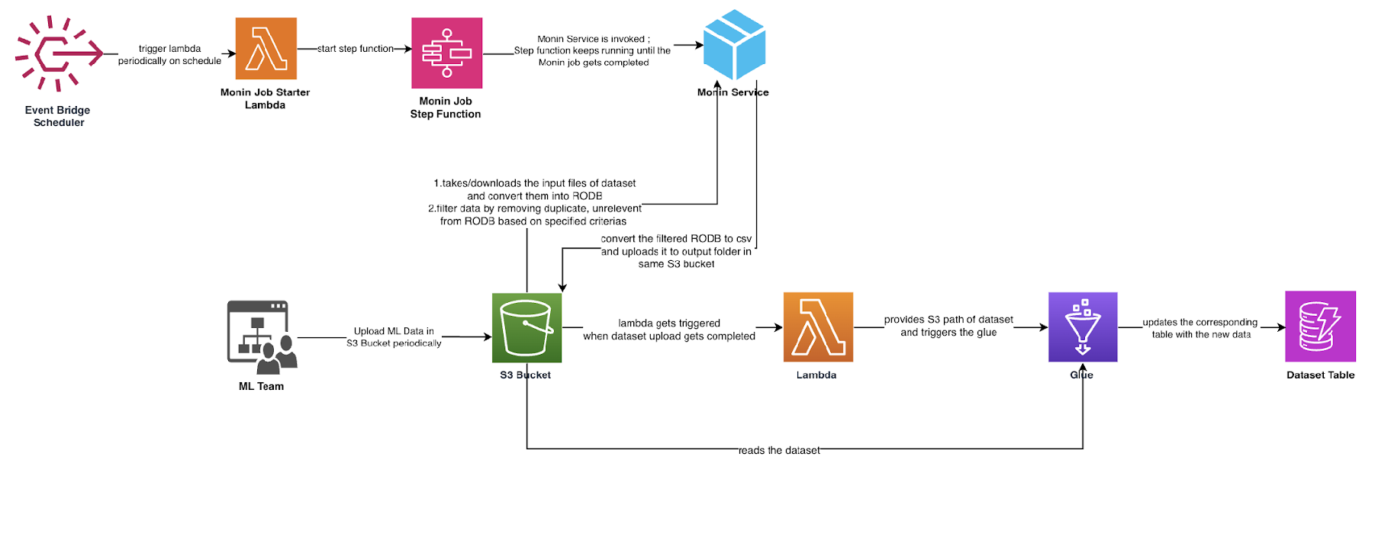
CURRENT ARCHITECTURE

Slide 7
SOLUTION
7

Slide 8
SOLUTION
developed a versatile utility that is not tied to any specific use case. This utility identifies and isolates the delta (changes) and stale data between current and previous datasets.
Focused on the update workflows of visually similar to solely process these deltas and stale entries instead of the entire dataset.

Slide 9
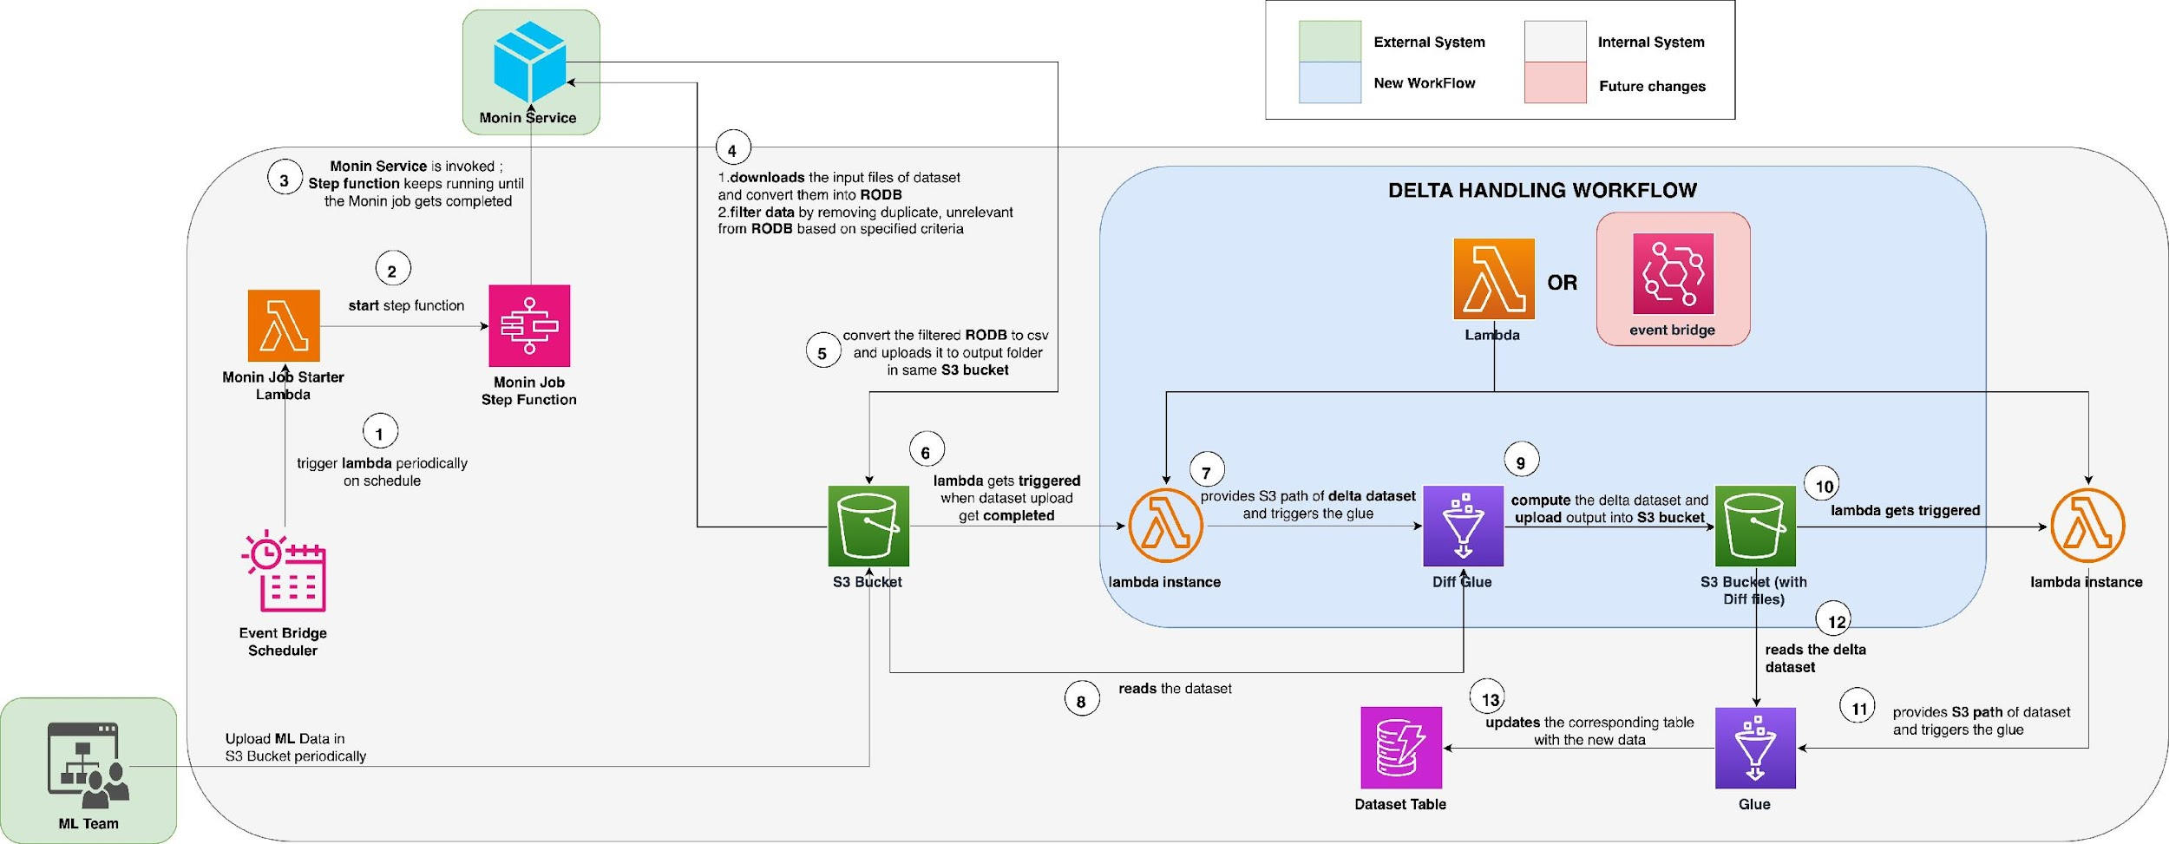
PROPOSED ARCHITECTURE

Slide 10
LOW-LEVEL IMPLEMENTATION
10

Slide 11
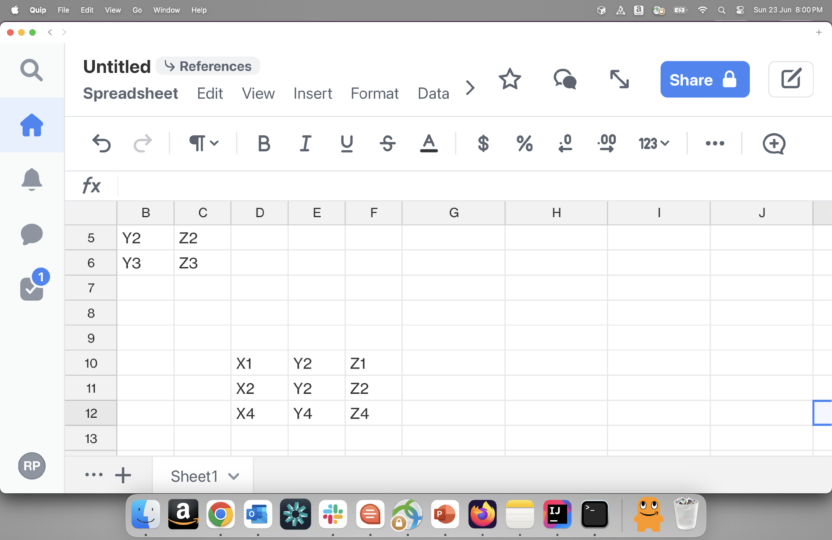
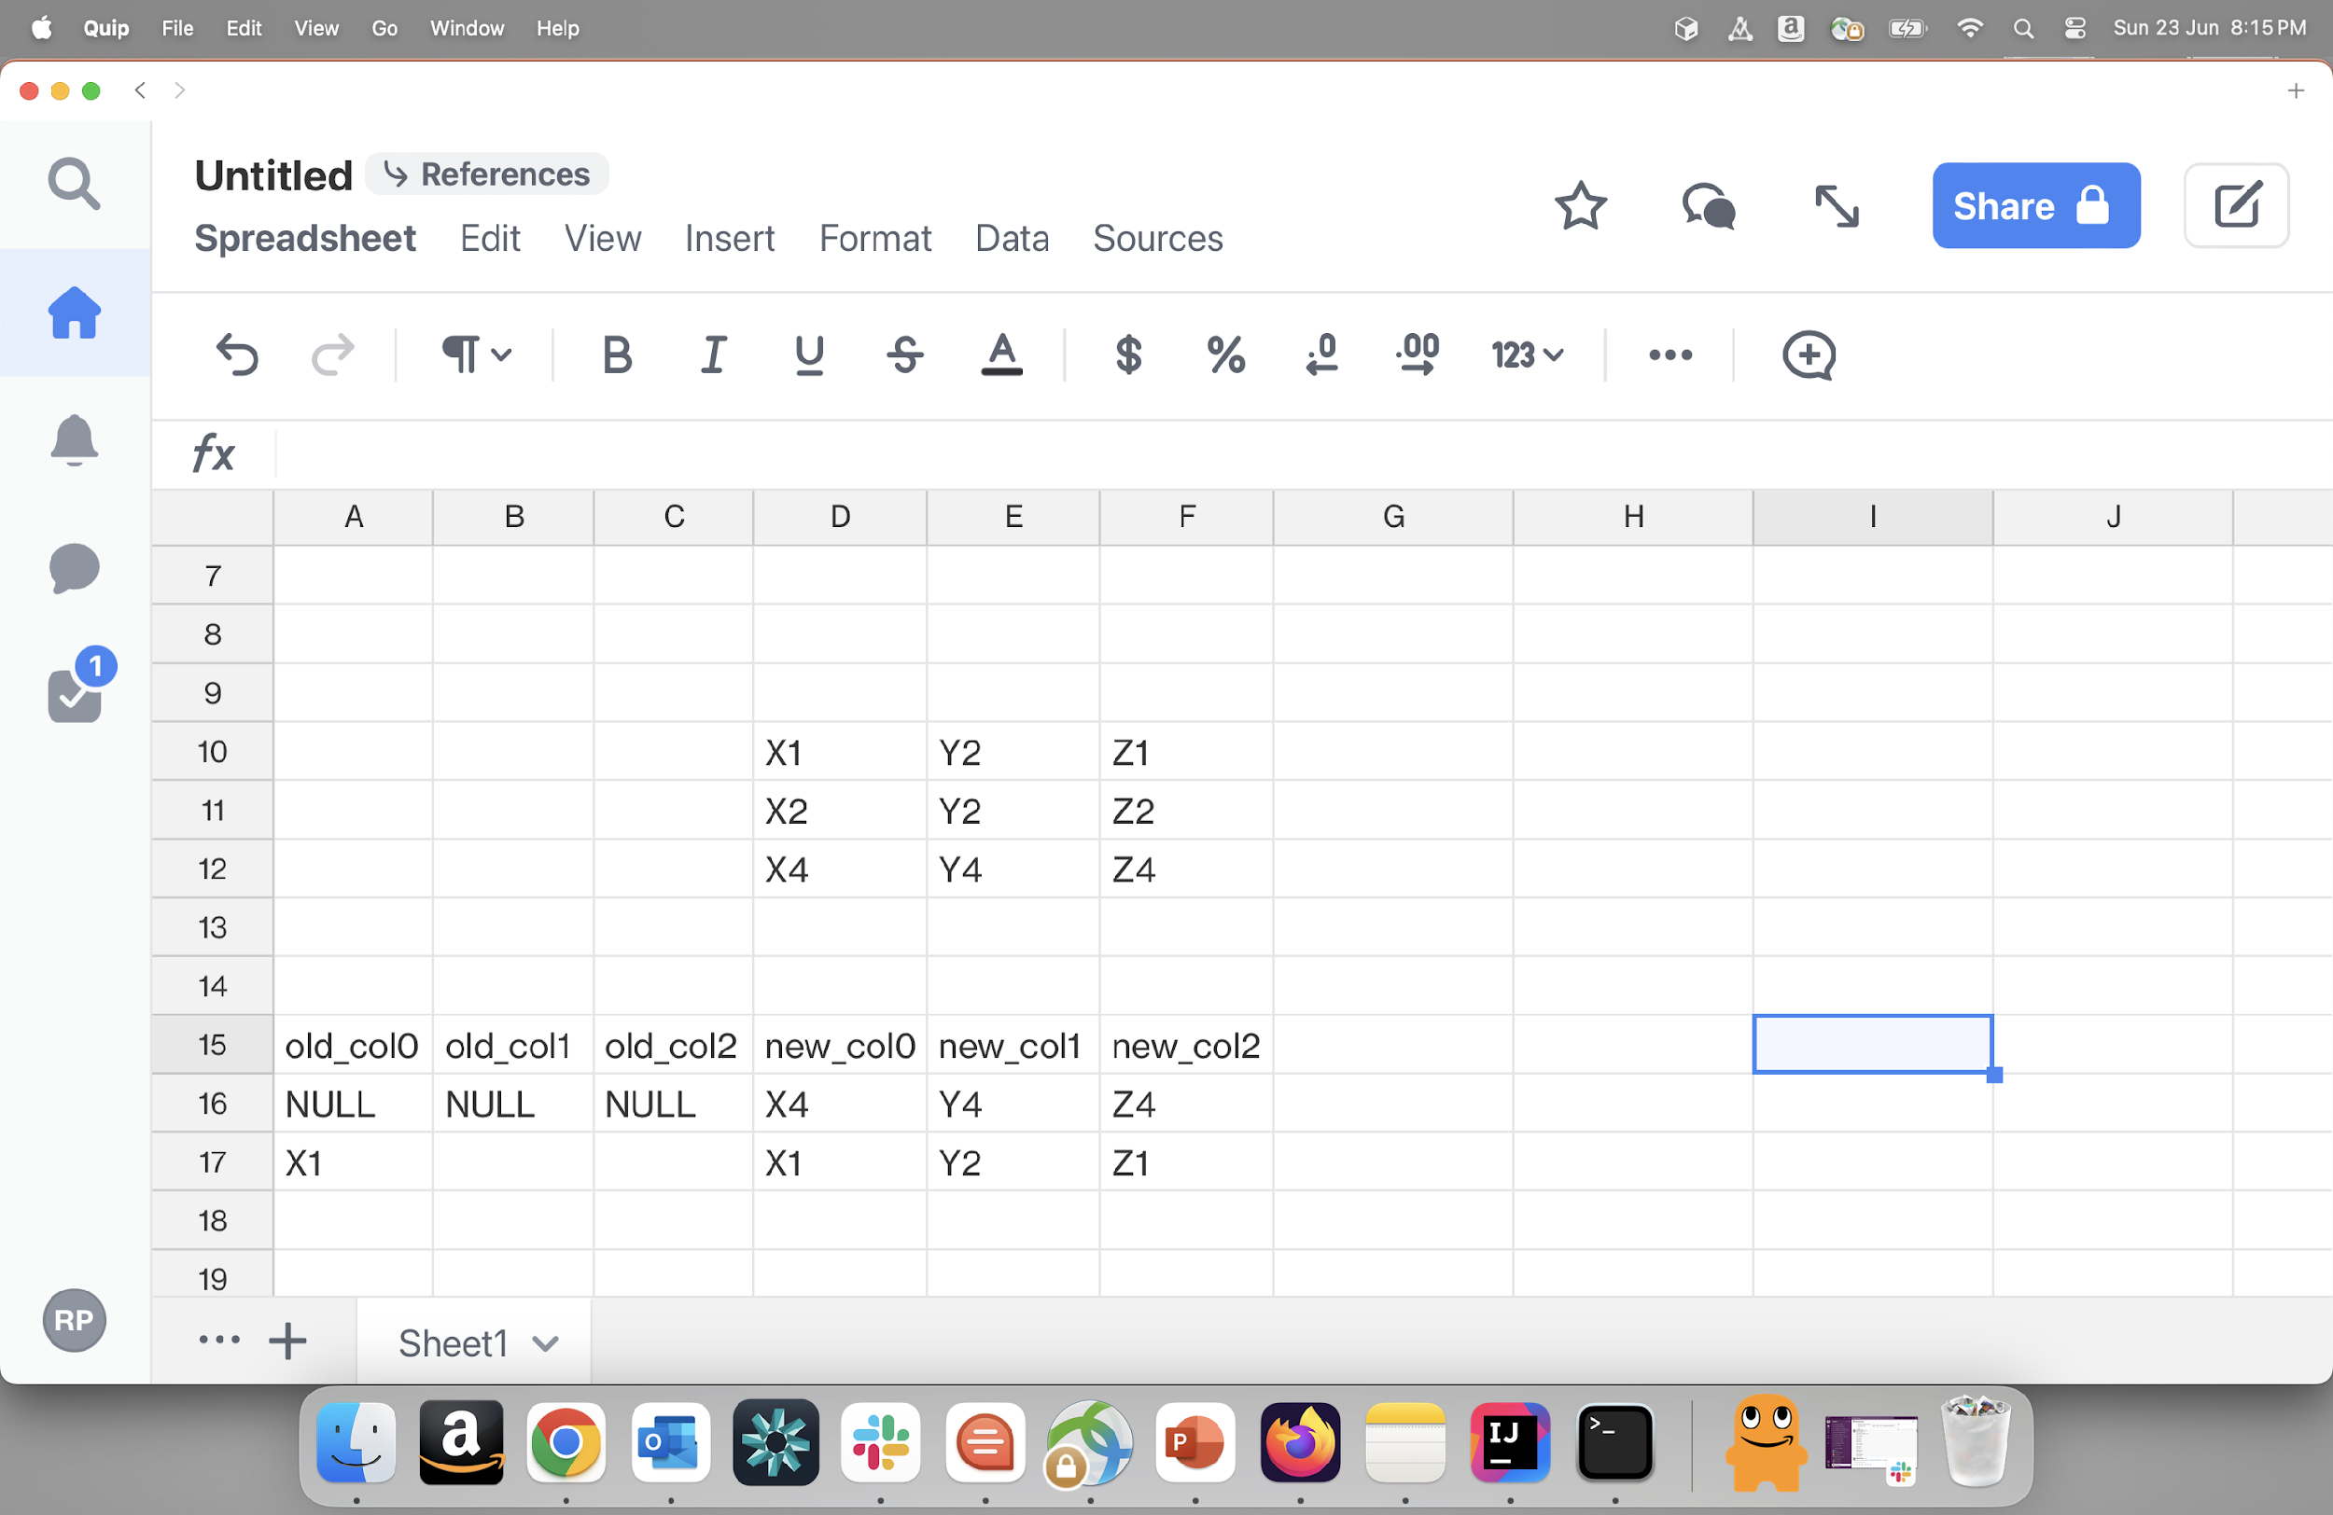
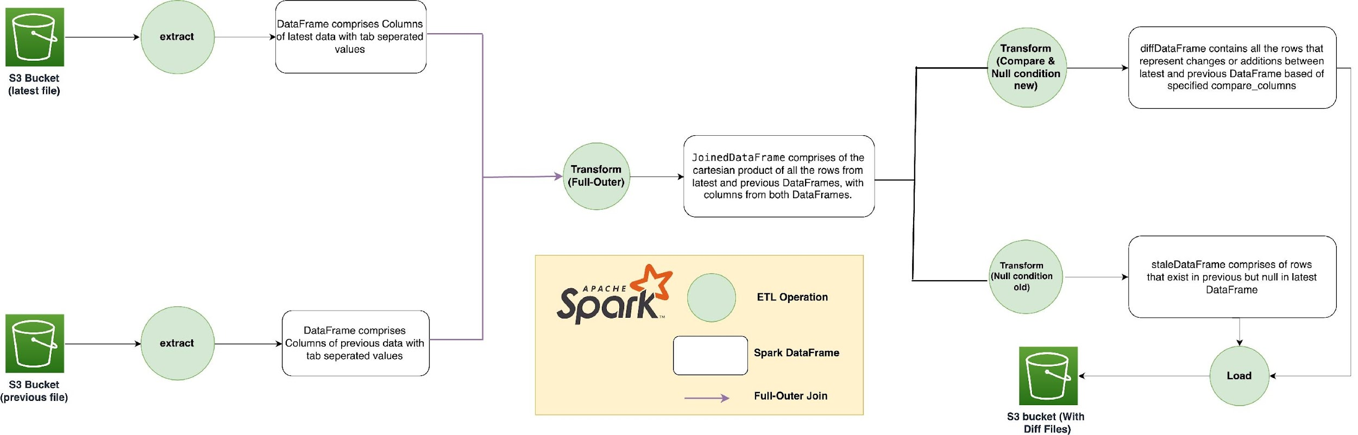
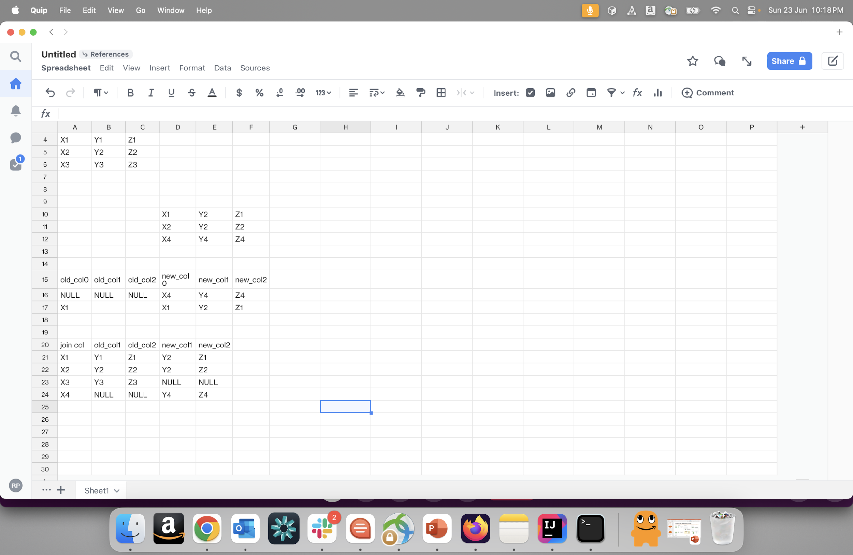
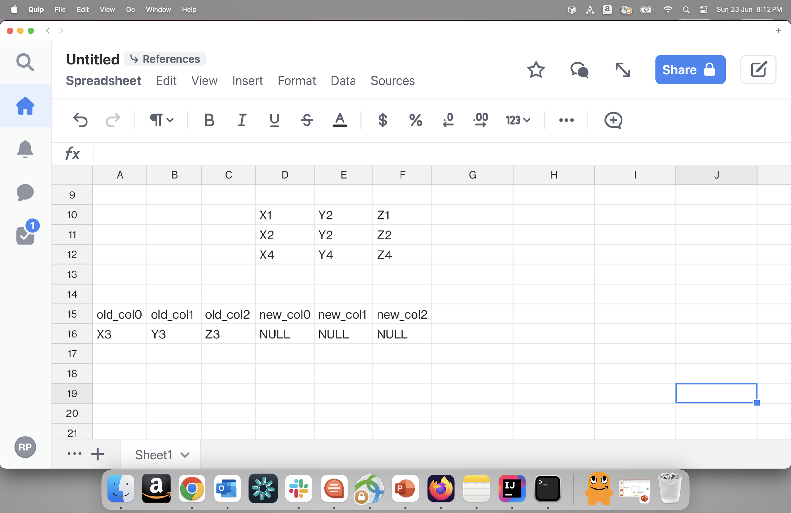
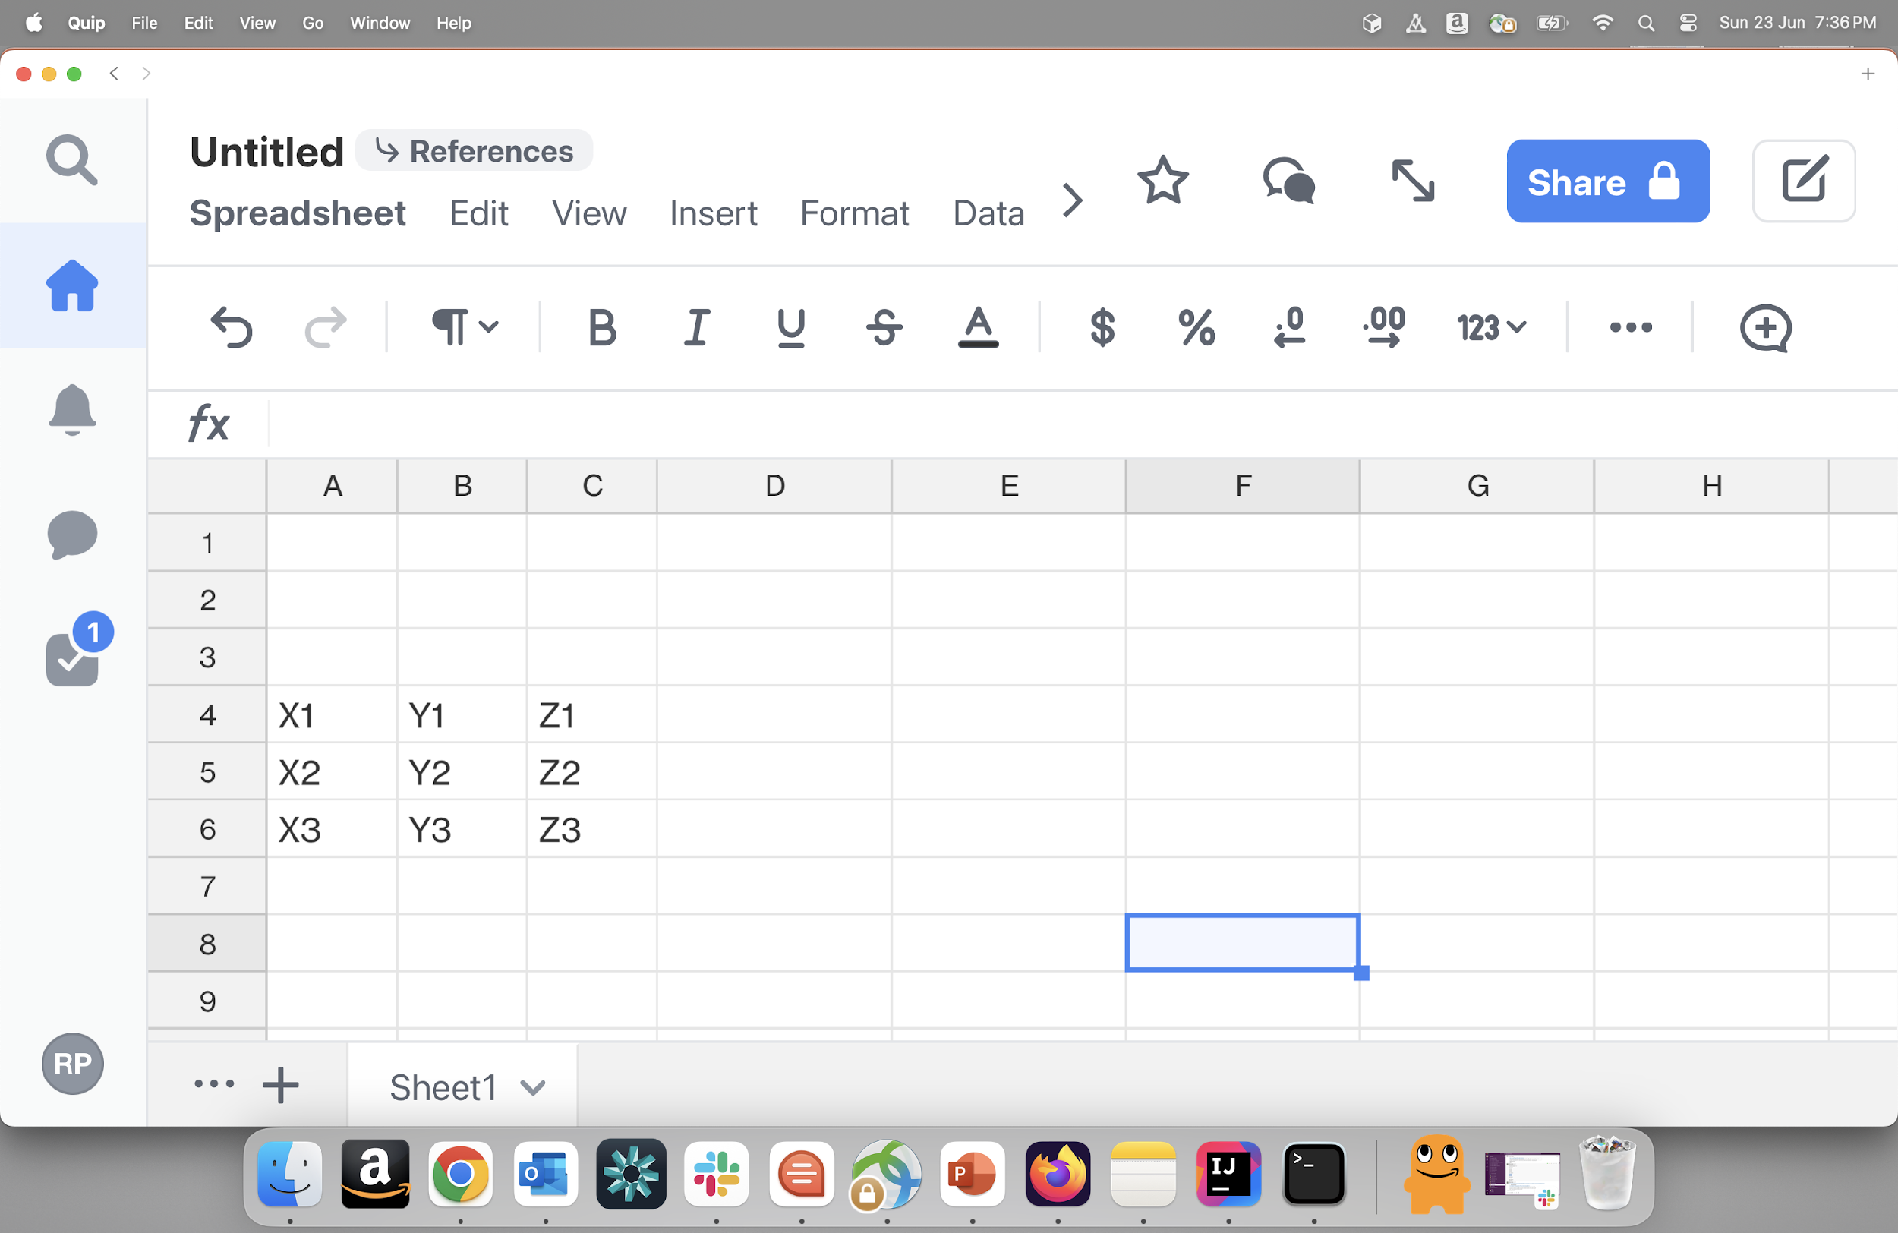
LOW-LEVEL IMPLEMENTATION
Latest data
Join column = X
Compare column = Y,Z
OUTPUT OF FULL OUTER JOIN
Previous data

Slide 12
RESULTS
14

Slide 13
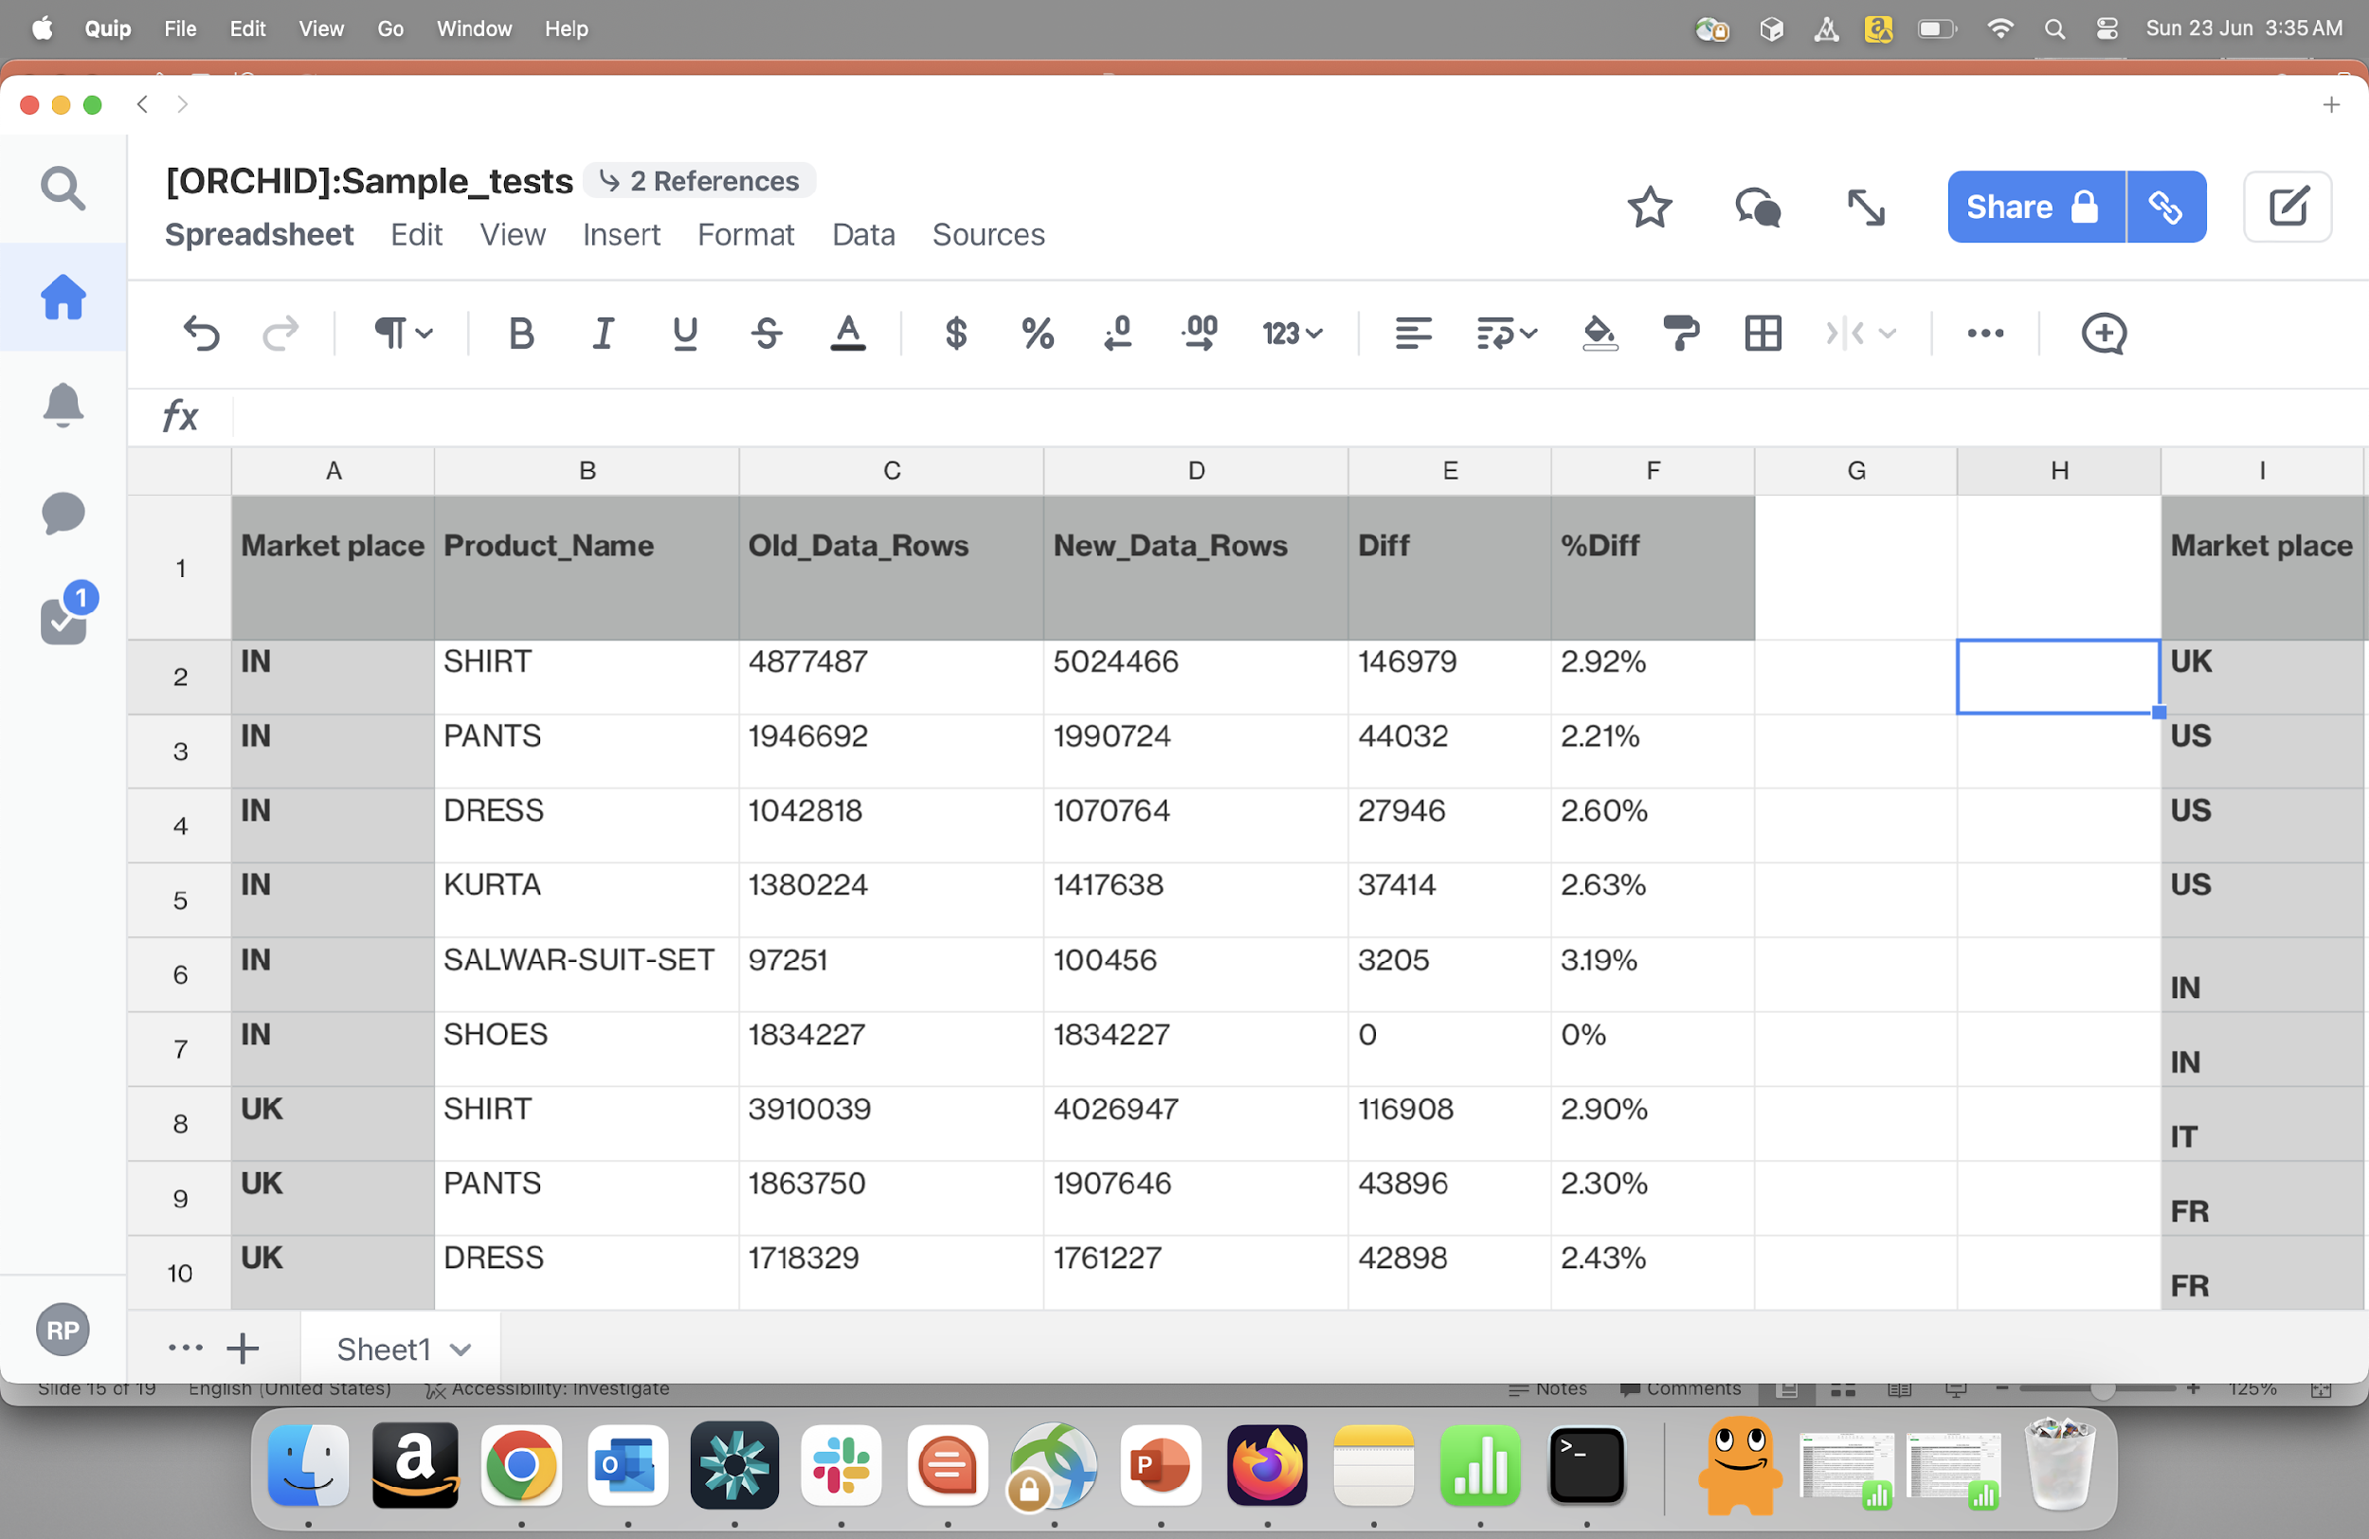
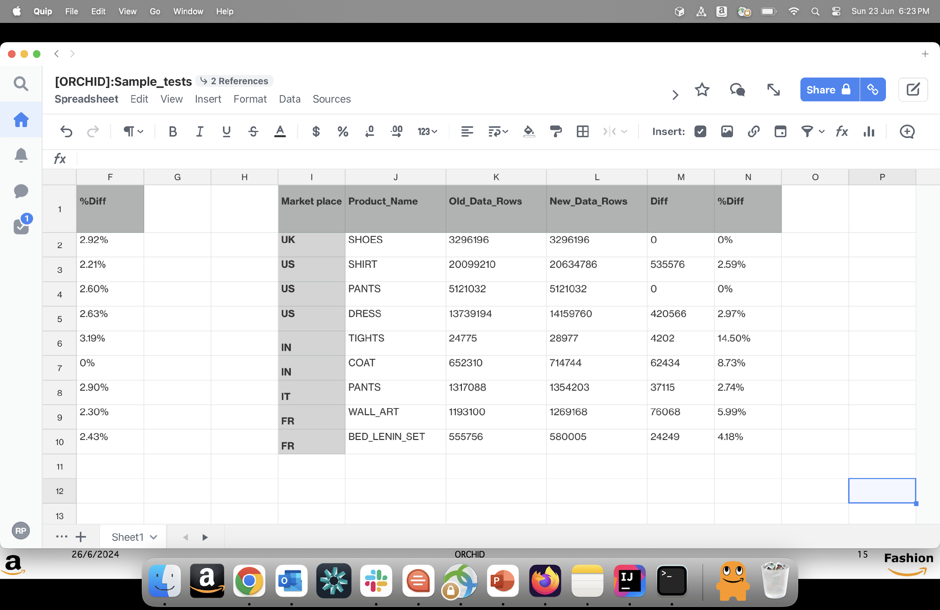
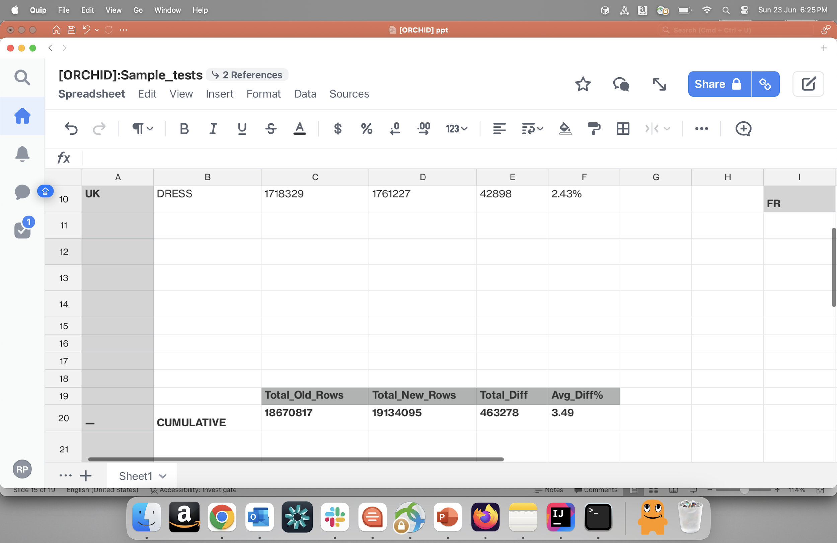
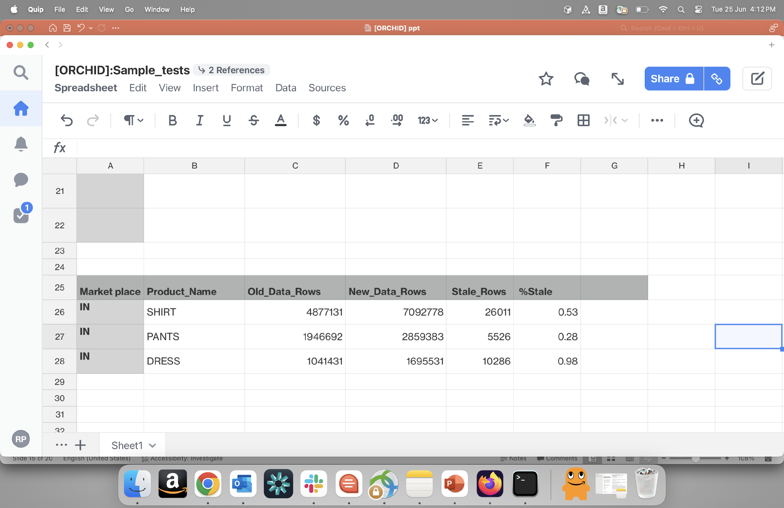
SAMPLE RESULT
Output of diff rows for some PT’S
Output of stale rows for some PT’S

Slide 14
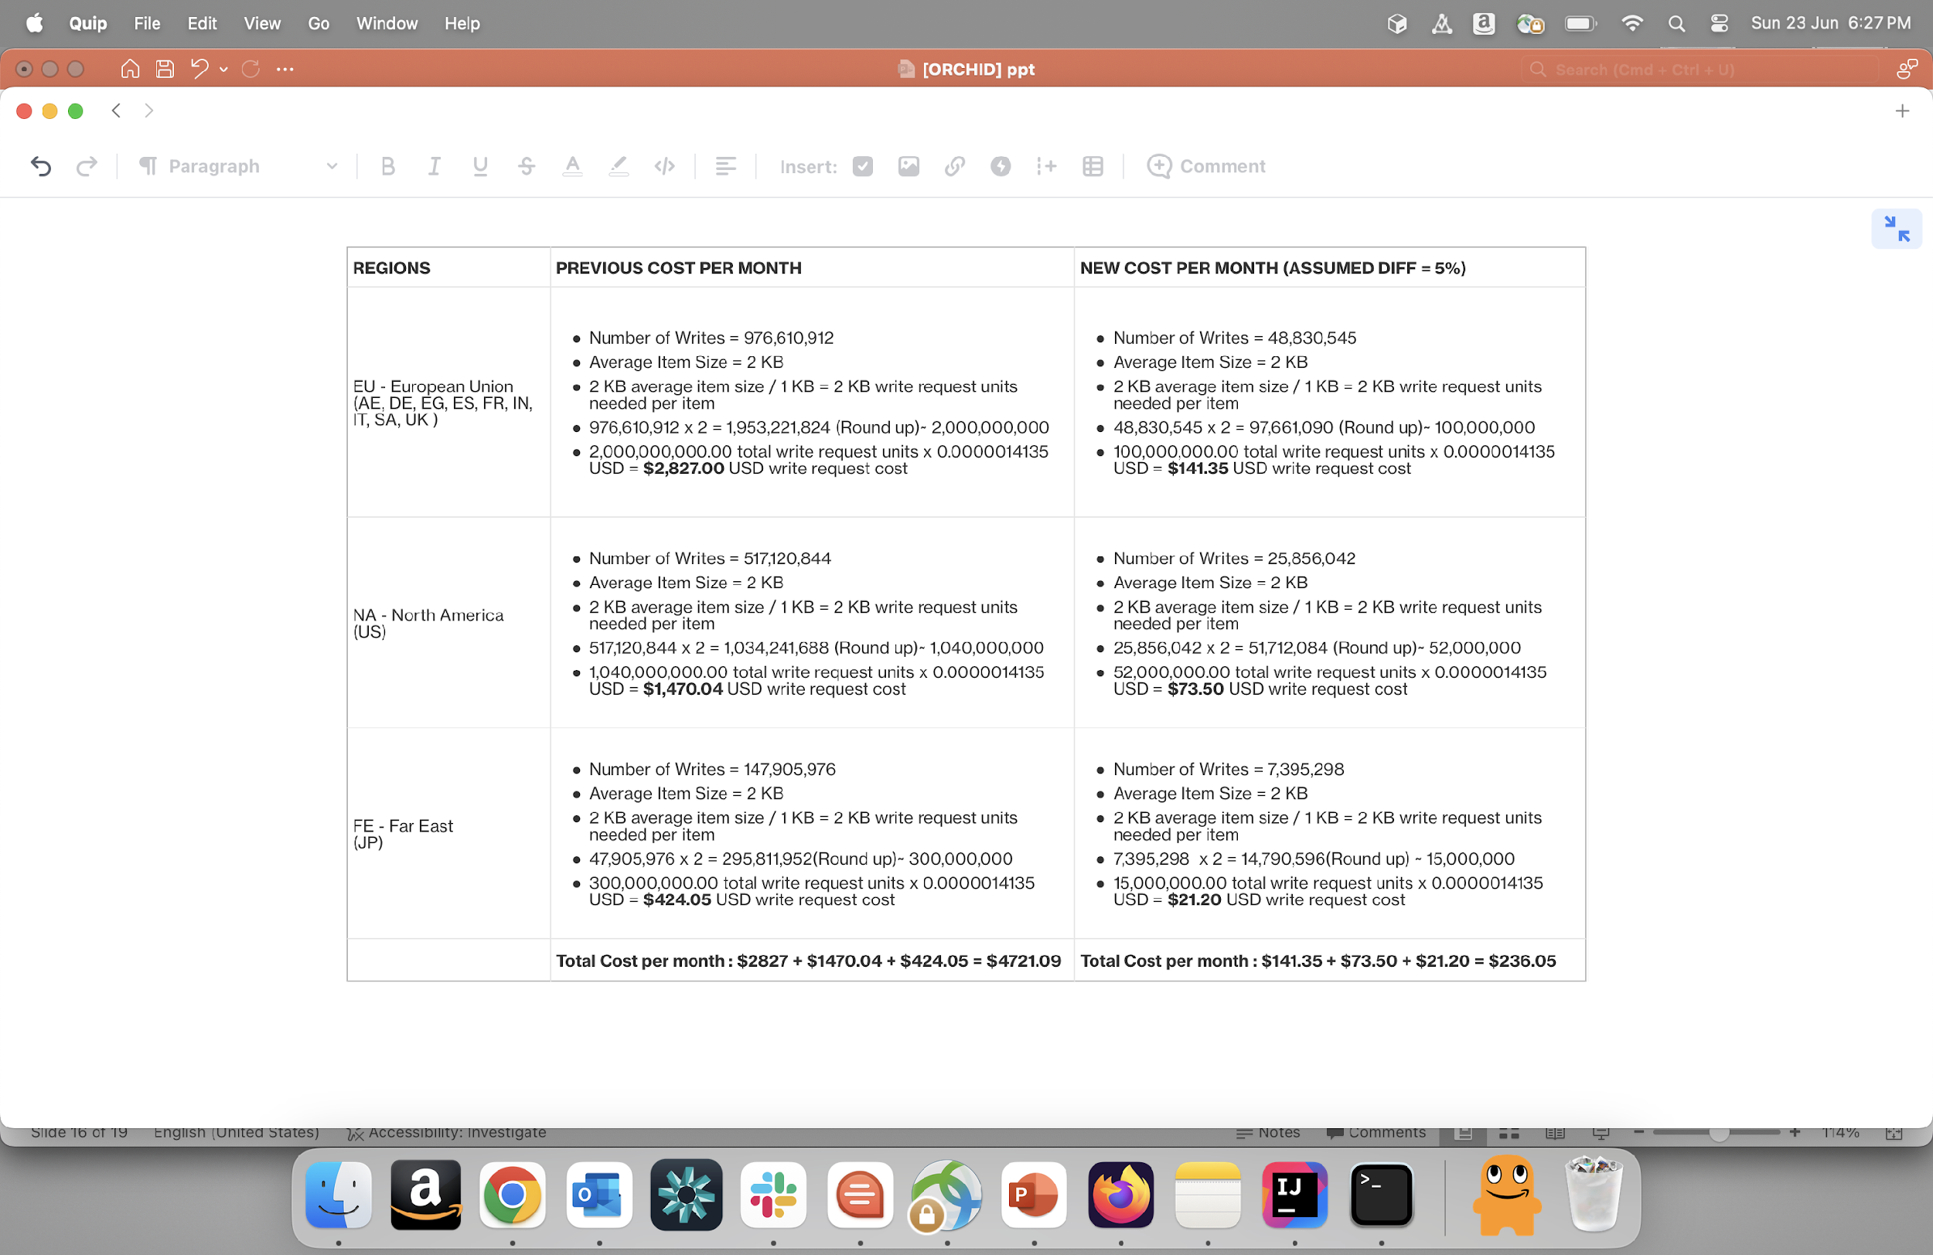
IMR COST ESTIMATION FOR VISUALLY SIMILAR
For Dynamo writes:

Slide 15
FUTURE SCOPE
17

Slide 16
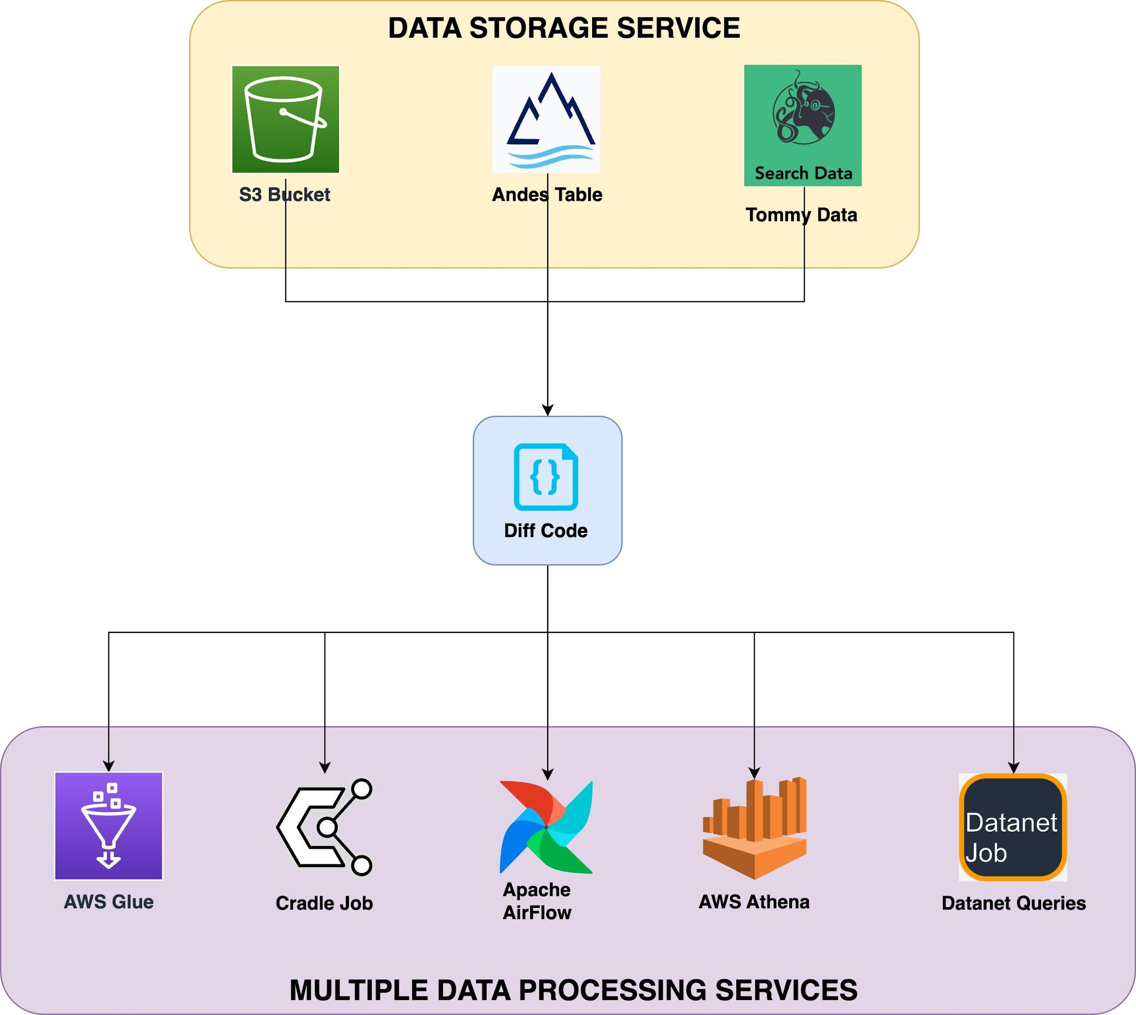
FUTURE SCOPE
1. Integrate into other projects, such as image backgrounds.
2. Integrate the Delta Computation Utility with multiple services.
26/6/2024
ORCHID

Slide 17
3. Imagine you have two datasets, D1 (Previous) and D2 (New). You want to extract specific rows from D2 based on conditions that involve not just the columns used for joining or comparing the datasets, but also an additional associated column. This extraction process can be further extended to handle numerical columns by specifying any operator (such as >, <, =, etc.).
EXAMPLE: * D1 : contains columns X, Y, Z.
* D2 : contains columns X, Y, Z.
Conditions:
* Join Column: X
* Compare Column: Y
* (NEW) Associate Column (Z): A new column that influences the extraction of rows in previous or latest based on a condition not directly related to the join or compare columns. (passed as dictionary).
combination : {
operator: “| / &”,
columns : [“col0", “col2”],
“col0” : {
values: [1,5,7],
dataset: previous/new,
},
”col2” : { values: [“A”,”C”],
dataset: previous/new }
}

Slide 18
Thank you
Q/A

